Slide 1
Logic and Propositional Calculus
PROPOSITIONS AND COMPOUND STATEMENTS
A proposition (or statement) is a declarative statement which is true or false, but not both.
Let us identify which of the following are propositions and which are not.
(i) PDEU is in Rajkot
(ii) Where are you going?
(iii) Arunachal Pradesh is a part of China.
(iv) 2 + 2 = 4
(v) Do your homework.

Slide 2
Compound Propositions
Many propositions are composite, that is, composed of subpropositions and various connectives discussed subsequently. Such composite propositions are called compound propositions.
A proposition is said to be primitive if it cannot be broken down into simpler propositions, that is, if it is not composite.
For example, the above propositions (i), (iii) and (iv) are primitive propositions.
On the other hand, the following two propositions are composite:
a) 2+2=4 and Surat city is in Maharashtra.
b) John is smart or he studies every night
The fundamental property of a compound proposition is that its truth value is completely determined by the truth values of its subpropositions together with the way in which they are connected to form the compound propositions.
Let us study some of these connectives from next slides.

Slide 3
BASIC LOGICAL OPERATIONS
Conjunction, p ∧ q
Any two propositions can be combined by the word “and” to form a compound proposition called the conjunction of the original propositions.
Symbolically, p ∧ q read “p and q,” denotes the conjunction of p and q.
Since p ∧ q is a proposition it has a truth value, and this truth value depends only on the truth values of p and q.
Specifically:
Definition: If p and q are true, then p ∧ q is true; otherwise p ∧ q is false.

Slide 4
Consider the following four statements:
(i) Ice floats in water and 2 + 2 = 4. (iii) China is in Europe and 2 + 2 = 4.
(ii) Ice floats in water and 2 + 2 = 5. (iv) China is in Europe and 2 + 2 = 5.
Only the first statement is true. Each of the others is false since at least one of its substatements is false.

Slide 5
Disjunction, p ∨ q
Any two propositions can be combined by the word “or” to form a compound proposition called the disjunction of the original propositions.
Symbolically, p ∨ q read “p or q,” denotes the disjunction of p and q.
The truth value of p ∨ q depends only on the truth values of p and q as follows.
Definition: If p and q are false, then p ∨ q is false; otherwise p ∨ q is true.

Slide 6
Consider the following four statements:
(i) Ice floats in water or 2 + 2 = 4. (iii) China is in Europe or 2 + 2 = 4.
(ii) Ice floats in water or 2 + 2 = 5. (iv) China is in Europe or 2 + 2 = 5.
Only the last statement (iv) is false. Each of the others is true since at least one of its sub-statements is true.

Slide 7
Negation, ￢p
Given any proposition p, another proposition, called the negation of p, can be formed by writing “It is not true that . . .” or “It is false that . . .” before p or, if possible, by inserting in p the word “not.”
Symbolically, the negation of p, read “not p,” is denoted by ￢p
The truth value of ￢p depends on the truth value of p as follows:
Definition: If p is true, then ￢p is false; and if p is false, then ￢p is true.

Slide 8
EXAMPLE: Consider the following six statements:
(a1) Ice floats in water. (a2) It is false that ice floats in water. (a3) Ice does not float in water.
(b1) 2 + 2 =5 (b2) It is false that 2 + 2 = 5. (b3) 2 + 2 = 5
Then (a2) and (a3) are each the negation of (a1); and (b2) and (b3) are each the negation of (b1).
Since (a1) is true, (a2) and (a3) are false; and since (b1) is false, (b2) and (b3) are true.

Slide 9
PROPOSITIONS AND TRUTH TABLES
Let P(p, q, . . .) denote an expression constructed from logical variables p, q, . . ., which take on the value
TRUE (T) or FALSE (F), and the logical connectives ∧, ∨, and ￢ (and others discussed subsequently). Such an expression P(p, q, . . .) will be called a proposition.
For example, the proposition ￢(p∧￢q).
Figure 4-2(a) indicates how the truth table of ￢(p∧￢q) is constructed. Observe that the first columns of the table are for the variables p, q, . . . and that there are enough rows in the table, to allow for all possible combinations of T and F for these variables.

Slide 10
Remark: 1) In order to avoid an excessive number of parentheses, we sometimes adopt an order of precedence for the logical connectives.
Specifically, ￢has precedence over ∧ which has precedence over ∨
For example, ￢p ∧ q means (￢p) ∧ q and not ￢(p ∧ q).
2) For 2 variables, as above, 4 rows are necessary; for 3 variables, 8 rows are necessary; and, in general, for n variables, 2n rows are required

Slide 11
TAUTOLOGIES AND CONTRADICTIONS
Some propositions P(p, q, . . .) contain only T in the last column of their truth tables or, in other words, they are true for any truth values of their variables. Such propositions are called tautologies.
Analogously, a proposition P(p, q, . . .) is called a contradiction if it contains only F in the last column of its truth table or, in other words, if it is false for any truth values of its variables.
For example: the proposition “p or not p,” that is, p ∨ ￢p, is a tautology,
and the proposition “p and not p,” that is, p∧￢p, is a contradiction
Note that the negation of a tautology is a contradiction since it is always false, and the negation of a contradiction is a tautology since it is always true.

Slide 12
LOGICAL EQUIVALENCE
Two propositions P(p, q, . . .) and Q(p, q, . . .) are said to be logically equivalent, or simply equivalent or equal, denoted by P(p, q, . . .) ≡ Q(p, q, . . .), if they have identical truth tables.
Consider, for example, the truth tables of ￢(p ∧ q) and ￢p∨￢q.
Observe that both truth tables are the same, that is, both propositions are false in the first case and true in the other three cases. Accordingly, we can write ￢(p ∧ q) ≡ ￢p ∨￢q
In other words, the propositions are logically equivalent.

Slide 13
Remark: Let p be “Roses are red” and q be “Violets are blue.” Let S be the statement:
“It is not true that roses are red and violets are blue.”
Then S can be written in the form ￢(p ∧ q). However, as noted above, ￢(p ∧ q) ≡ ￢p ∨ ￢q. Accordingly, S has the same meaning as the statement: “Roses are not red, or violets are not blue.”

Slide 14
ALGEBRA OF PROPOSITIONS

Slide 15
CONDITIONAL AND BICONDITIONAL STATEMENTS
Many statements, are of the form “If p then q.” Such statements are called conditional statements and are denoted by p → q
The conditional p → q is frequently read “p implies q” or “p only if q.”
The conditional p → q is false only when the first part p is true and the second part q is false. Accordingly, when p is false, the conditional p → q is true regardless of the truth value of q.

Slide 16
Another common statement is of the form “p if and only if q.” Such statements are called biconditional statements and are denoted by p ↔ q
The biconditional p ↔ q is true whenever p and q have the same truth values and false otherwise.

Slide 17
Note that the truth table of ￢p ∨q and p → q are identical, that is, they are both false only in the second case. Accordingly, p → q is logically equivalent to ￢p ∨ q; that is,
p → q ≡ ￢p ∨ q
In other words, the conditional statement “If p then q” is logically equivalent to the statement “Not p or q” which only involves the connectives ∨ and ￢ and thus was already a part of our language

Slide 18
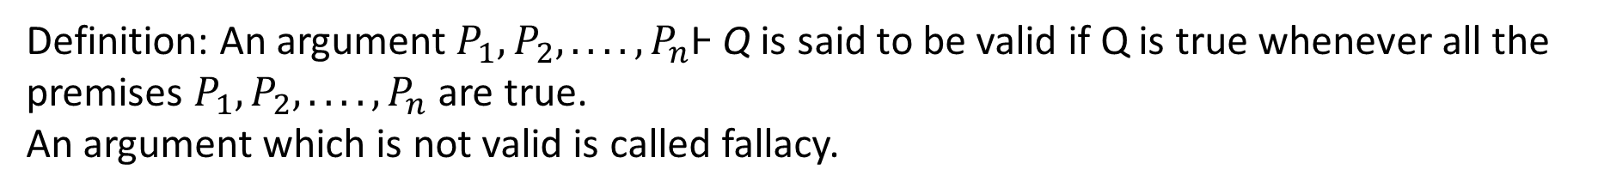
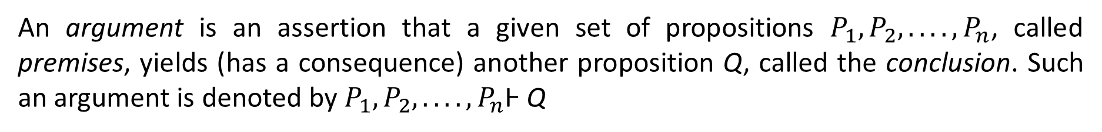
ARGUMENTS
An argument is an assertion that a given set of propositions $P_{1}, P_{2}, . . . . ,P_{n}$, called premises, yields (has a consequence) another proposition Q, called the conclusion. Such an argument is denoted by $P_{1}, P_{2}, . . . . ,P_{n}$Ͱ Q
Definition: An argument $P_{1}, P_{2}, . . . . ,P_{n}$Ͱ Q is said to be valid if Q is true whenever all the premises $P_{1}, P_{2}, . . . . ,P_{n}$ are true.
An argument which is not valid is called fallacy.
EXAMPLE:
(a) The following argument is valid:
p, p → q Ͱ q (Law of Detachment)
The proof of this rule follows from the truth table on slide 15.
Specifically, p and p → q are true simultaneously only in Case (row) 1, and in this case q is true.

Slide 19
(b) The following argument is a fallacy:
p → q, q Ͱ p
For p → q and q are both true in Case (row) 3 in the truth table on slide 15 but in this case p is false.
Theorem 4.3: The argument P1, P2, . . . , Pn Ͱ Q is valid if and only if the proposition ($P_{1}, P_{2}, . . . . ,P_{n}$) → Q is a tautology.

Slide 20
EXAMPLE: A fundamental principle of logical reasoning states:
“If p implies q and q implies r, then p implies r”
That is, the following argument is valid: p → q, q → r Ͱ p →r (Law of Syllogism)

Slide 21
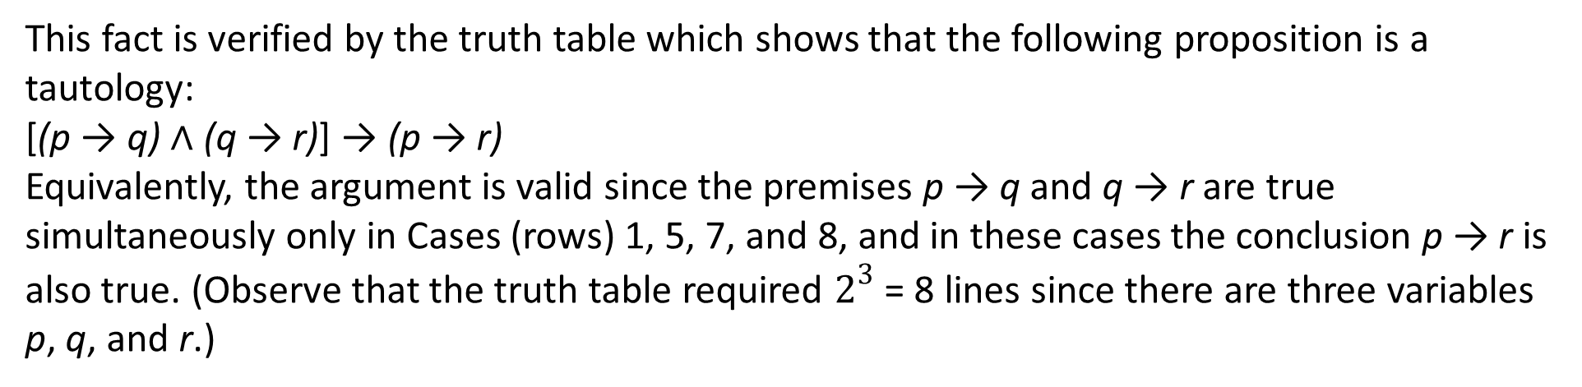
This fact is verified by the truth table which shows that the following proposition is a tautology:
[(p → q) ∧ (q → r)] → (p → r)
Equivalently, the argument is valid since the premises p → q and q → r are true simultaneously only in Cases (rows) 1, 5, 7, and 8, and in these cases the conclusion p → r is also true. (Observe that the truth table required $2^{3}$ = 8 lines since there are three variables p, q, and r.)

Slide 22
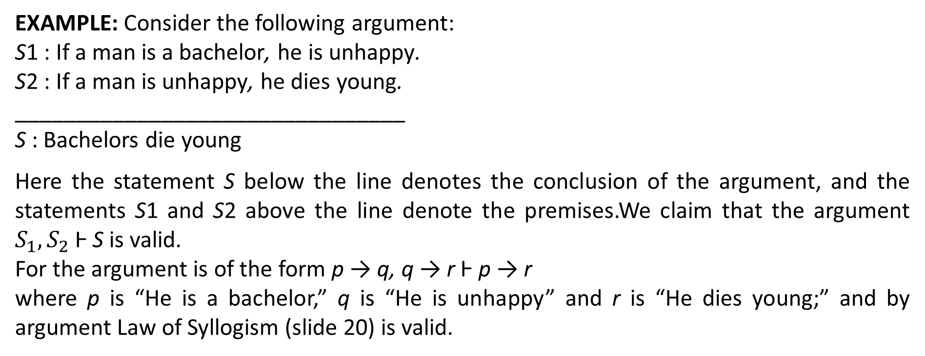
EXAMPLE: Consider the following argument:
S1 : If a man is a bachelor, he is unhappy.
S2 : If a man is unhappy, he dies young.
________________________________
S : Bachelors die young
Here the statement S below the line denotes the conclusion of the argument, and the statements S1 and S2 above the line denote the premises.We claim that the argument $S_{1}, S_{2}$Ͱ S is valid.
For the argument is of the form p → q, q → r Ͱ p → r
where p is “He is a bachelor,” q is “He is unhappy” and r is “He dies young;” and by argument Law of Syllogism (slide 20) is valid.

